Slide 1

Predicting customer buying behaviour
12/02/2025

Slide 2
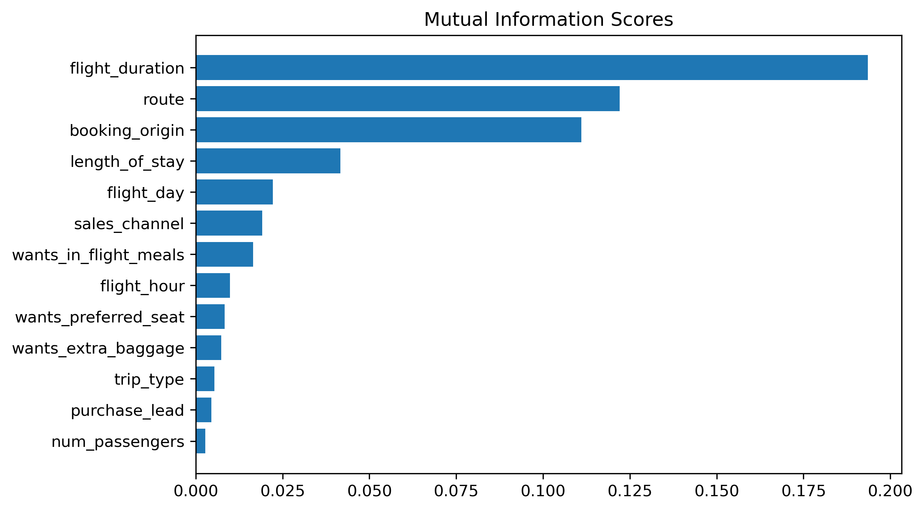
predictive model to understand factors that influence buying behaviour
Dataset is highly imbalanced so we use SMOTE to generate synthetic data of minority class and then We have trained the data set with Random forest classifier model and received
ACCURACY: 79.06%
AUC score: 0.61
flight duration
route
Booking origin
Length of stay
Flight day
Top 5 features which influence Customer buying behavior
We need to increase the AUC score

